Slide 1
Picture Prompts: Problem Posing and Problem Solving
Alison Kiddle (they/them)
9 December 2022

Slide 6
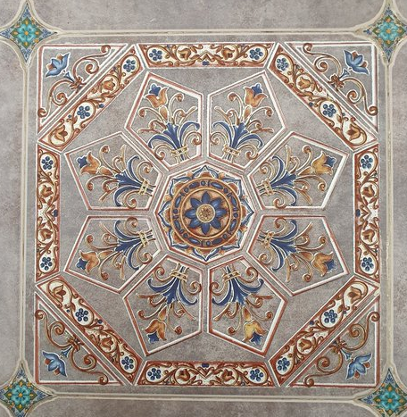
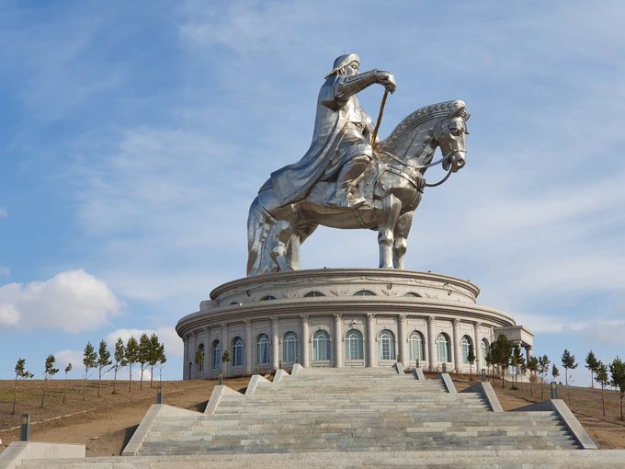
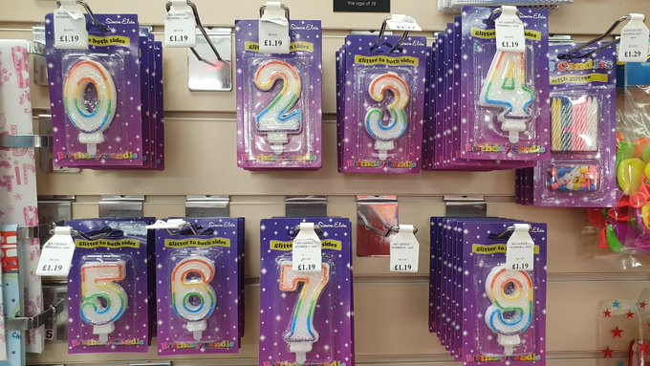

Slide 7
Picture prompts…
stimulate curiosity
showcase maths in everyday life
encourage creative thinking

Slide 8
How many? How did you count them?

Slide 9
How many? What comes next?

Slide 10
What are the ‘obvious’ questions?

Slide 11
Battenberg Sequences
How many yellow squares in the fifth shape?
The 10th shape?
The n^{th} shape?

Slide 12
AQA foundation practice papers set 2 Q11

Slide 13
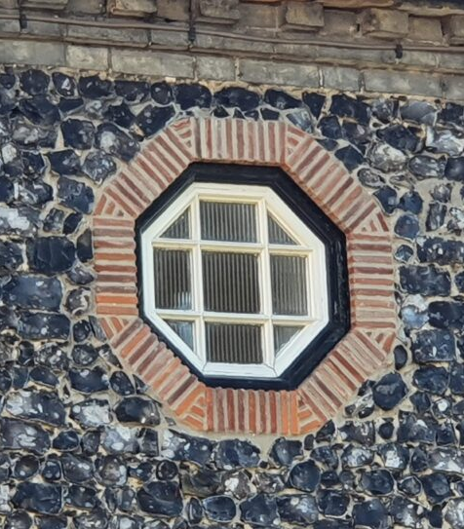
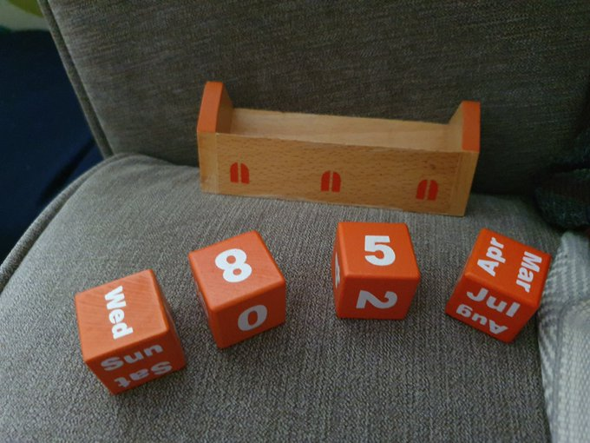

Slide 14
More ideas…
Twitter #NoticeWonder, #NoticeAndWonder
Which one doesn’t belong? #WODB
https://alisonkiddle.co.uk/noticing-and-wondering/

