Slide 1
How to cure maths anxiety
Alison Kiddle

Slide 2
What is maths anxiety?
Anxiety (noun): a feeling of worry, nervousness, or unease about something with an uncertain outcome.
“Many children and adults experience feelings of anxiety, apprehension, tension or discomfort when they are confronted by mathematics.” Carey et al, 2019

Slide 3
Maths at school
A high-stakes gatekeeping qualification
Packed curriculum
Speedy calculation valued
“TIRED” - Tedium, Isolation, Rote learning, Elitism and Depersonalisation (Nardi & Steward 2003)

Slide 4
“Students learn that mathematics is not something you do, but something that is done to you.”
Paul Lockhart
“I was made to learn by heart: ‘The square of the sum of two numbers is equal to the sum of their squares increased by twice their product.’ I had not the vaguest idea what this meant and when I could not remember the words, my tutor threw the book at my head, which did not stimulate my intellect in any way.”
Bertrand Russell

Slide 5
Two styles of question
What is the area of this rectangle?
Draw some rectangles and work out their areas.
Can you find a rectangle with an area of 24cm² ?
Can you find another?
4 cm
6 cm

Slide 6
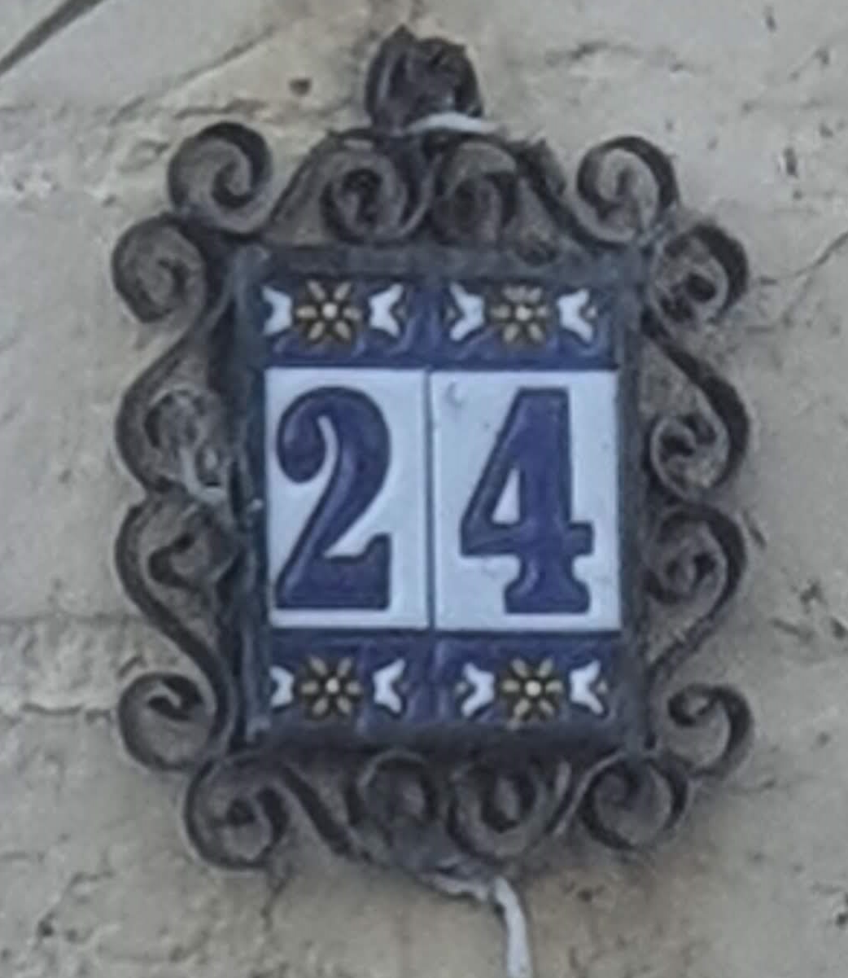
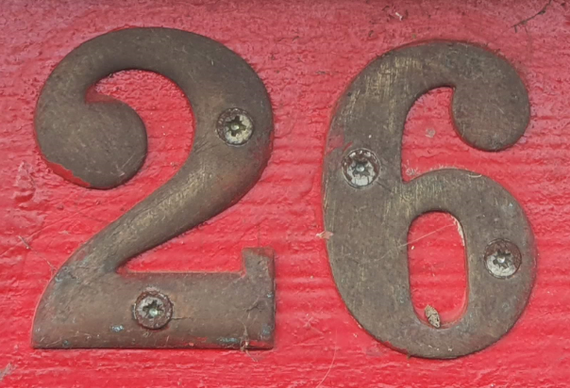
What do you notice?

Slide 7
If this is second in a sequence…
what might come first?
Or third?
Or…

Slide 8
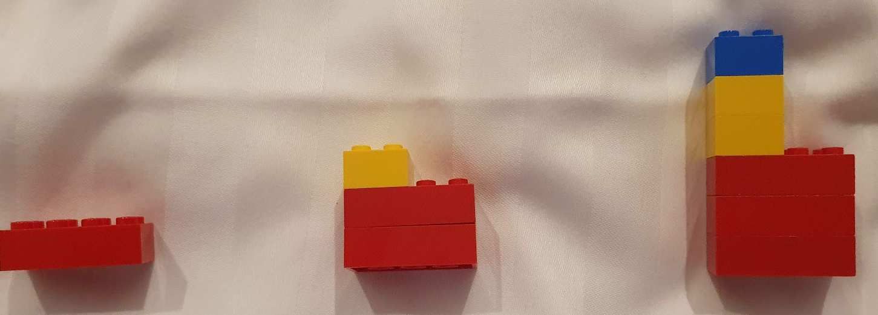

Slide 9
Maths is…
Playful
Creative
Connected
Human

Slide 10
If we offer people multiple ways to be successful in mathematics…
…many people will succeed mathematically

Slide 11
If you are maths anxious…
Find the maths you already do and are good at
Appreciate even if you do not enjoy
Try a growth mindset approach
Remember it’s not a race!

Slide 12
If you want to help others…
Celebrate mistakes – they’re a springboard to learning
Encourage play
Point out everyday maths
Make maths spaces safe spaces

Slide 13
Twitter: @alisonkiddle
Website: https://alisonkiddle.co.uk/how-to-cure-maths-anxiety/

Slide 14
References
Carey, E., Devine, A., Hill, F., Dowker, A., McLellan, R., & Szucs, D. (2019). Understanding Mathematics Anxiety: Investigating the experiences of UK primary and secondary school students. https://doi.org/10.17863/CAM.37744
Nardi, Elena & Steward, Susan. (2003). Is Mathematics T.I.R.E.D? A Profile of Quiet Disaffection in the Secondary Mathematics Classroom. British Educational Research Journal - BR EDUC RES J. 29. 345-366. 10.1080/01411920301852.

